Slide 1

Identifying optimal flight for “SkyHigh Travels”
By Vinayak Sharma & Yash Soni
Odette School Of Business

Slide 2

Background
SkyHigh Travels, a prominent travel agency, is committed to delivering excellent service by providing the best possible value for their clients' time and money.

Slide 3

Objective:
To Identify the best flight option for the route : New Delhi to Toronto

Slide 4
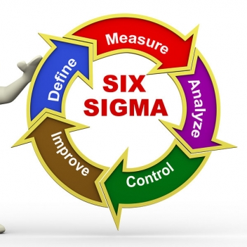
Lean Six Sigma-DMAIC
This Photo by Unknown author is licensed under CC BY-SA-NC.
Notes:
Lean Six Sigma is a team-focused managerial approach that seeks to improve performance by eliminating resource waste and defects
DMAIC is the problem-solving approach that drives Lean Six Sigma

Slide 5
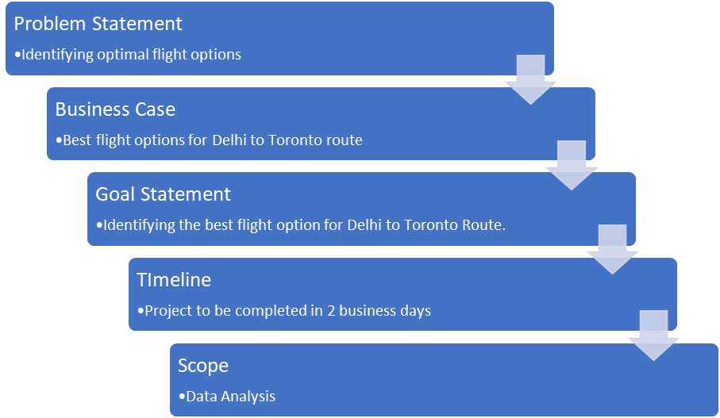
Define:
Project Charter showing the workflow of the project

Slide 6
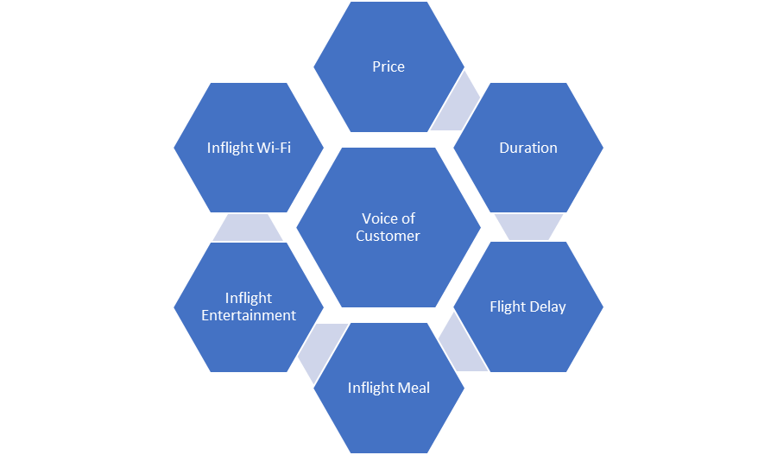
Voice of Customer
This helped us gather vital information regarding what customer think and feel about the experience with the business
The goal here was to learn about their expectation

Slide 7
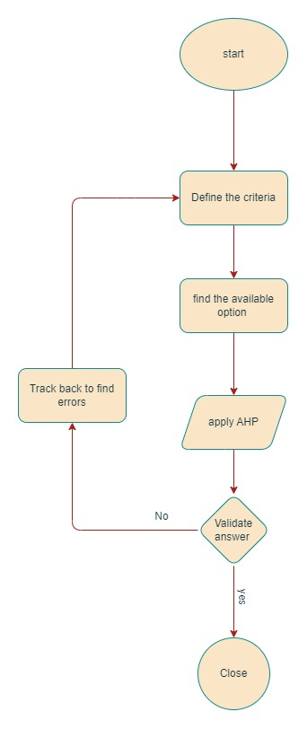
Measure:
Developed a Process Map which provided a workflow to perform Analytical Hierarchy Process

Slide 8

About The Data:
Quantitative Data:
Ticket price
Flight Duration
Flight Delay
Qualitative Data:
Inflight Meal
Inflight WIFI
Inflight Entertainment

Slide 9

Dealing With Qualitative Data
Combined all quantitative data and assigned weights according to the number of “Yes” in the data. For each “Yes” , 0.25 was assigned as their weight.
Eg: yes, no, no =0.25, yes, no, yes= 0.5

Slide 10
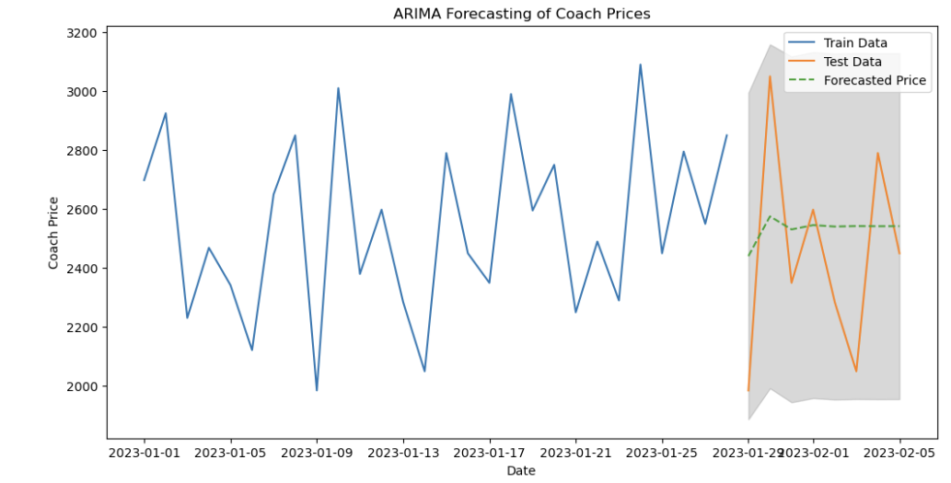
Forecasting: Price
Notes:
(auto regressive integrated moving average) ARIMA,
is a statistical analysis model that uses time series data to either better understand the data set or to predict future trends. A statistical model is autoregressive if it predicts future values based on past value
Simple flexible model
stationary
d, is the minimum number of differencing needed to make the series stationary. time series is already stationary, then d = 0.
‘p’ is the order of the ‘Auto Regressive’ (AR) term. number of lags of Y to be used as predictors.
‘q’ is the order of the ‘Moving Average’ (MA) term. It refers to the number of lagged forecast errors that should go into the ARIMA Model.

Slide 11

Analytical Hierarchy Process:
AHP is a multi-criteria decision-making method developed by Thomas L. Saaty

Slide 12
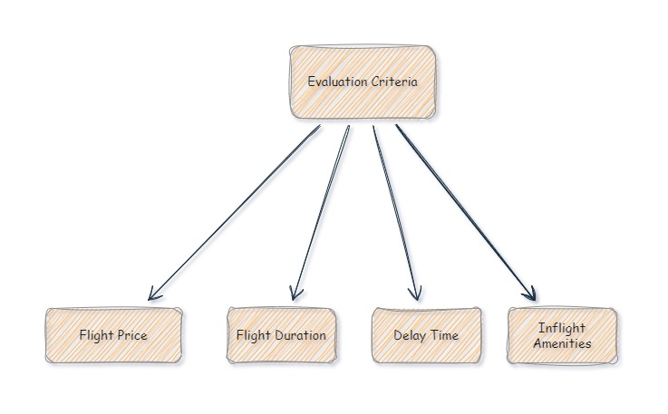
Decision Hierarchy:
Four main Criteria:
Flight Price: Ticket Cost
Flight Duration : Total time to reach the destination
Delay Time : Delay in take-off
Inflight Amenities : Amenities like WIFI, Meal option and Entertainment

Slide 13
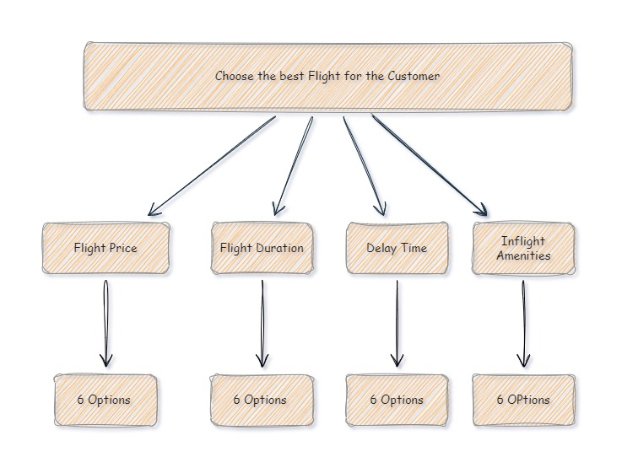
Airlines under Evaluation:
Airlines being evaluated: Air India, Air Canada, Lufthansa, Emirates, British Airways and Qatar Airways

Slide 14

Analysis Phase: AHP Process and using Python to find the most Optimal Flight option
Now will move to Excel file and then to jupyter Notebook.

Slide 15
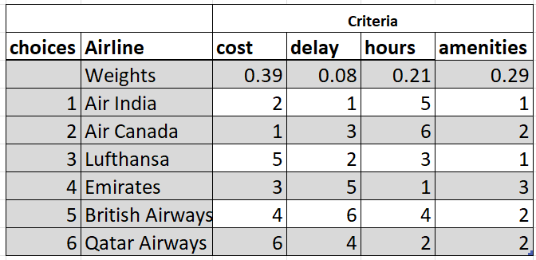
Control phase: Weighed Sum Model
Simple aggregation method for multi-criteria decision-making.
It is based on the idea of assigning weights to each criterion and then calculating a weighted sum for each alternative based on the scores on the criteria.
The model does not involve any pairwise comparisons or eigenvector calculations like AHP.
The weighted sum of scores for each alternative represents its overall performance, and the alternative with the highest weighted sum is considered the best option.

Slide 16
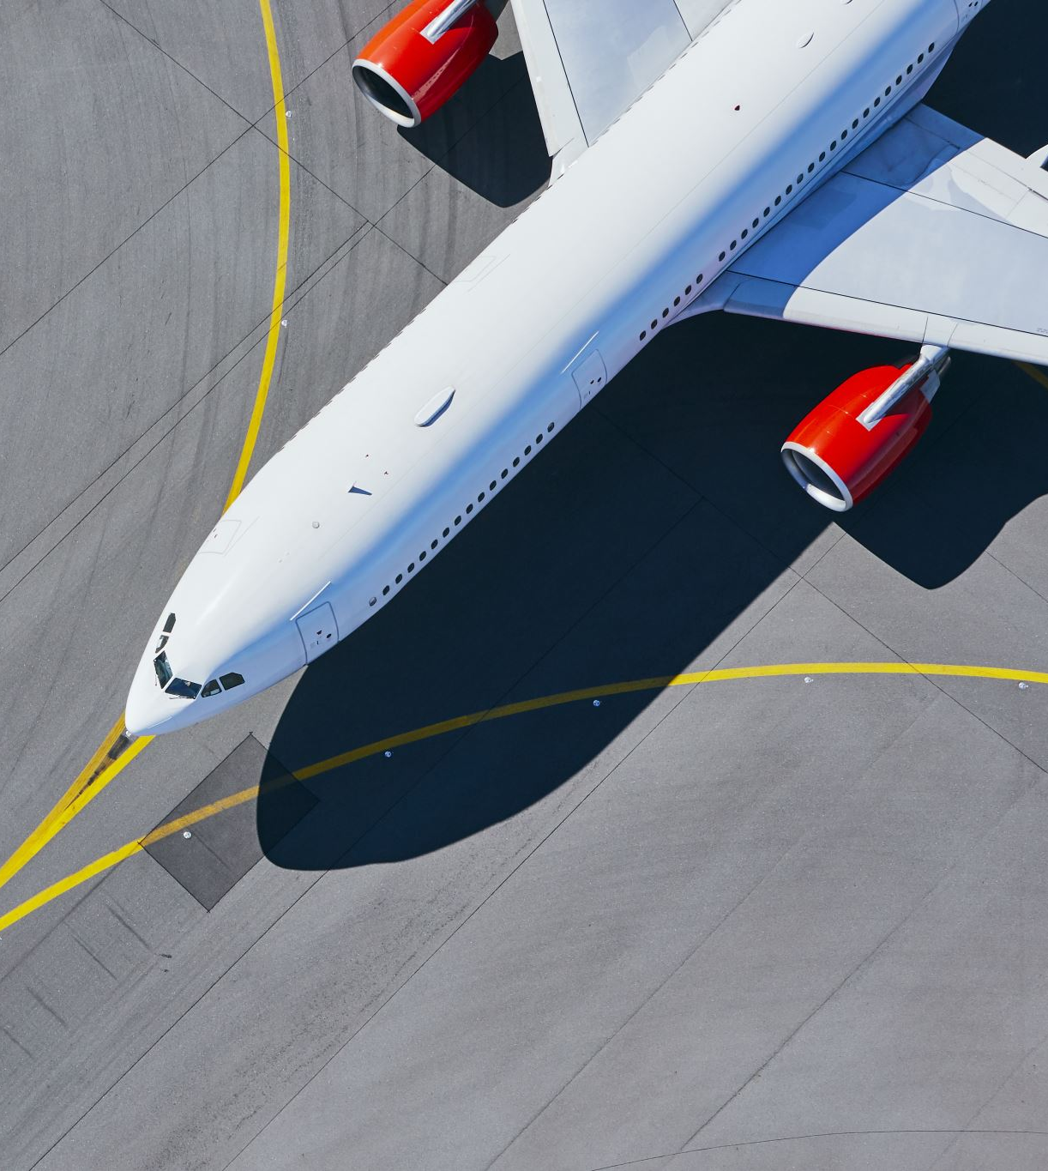
Conclusion:
Through AHP, the optimal flight option from New Delhi to Toronto is Qatar Airways.

Slide 17

Thank you Any Questions?

